Slide 1
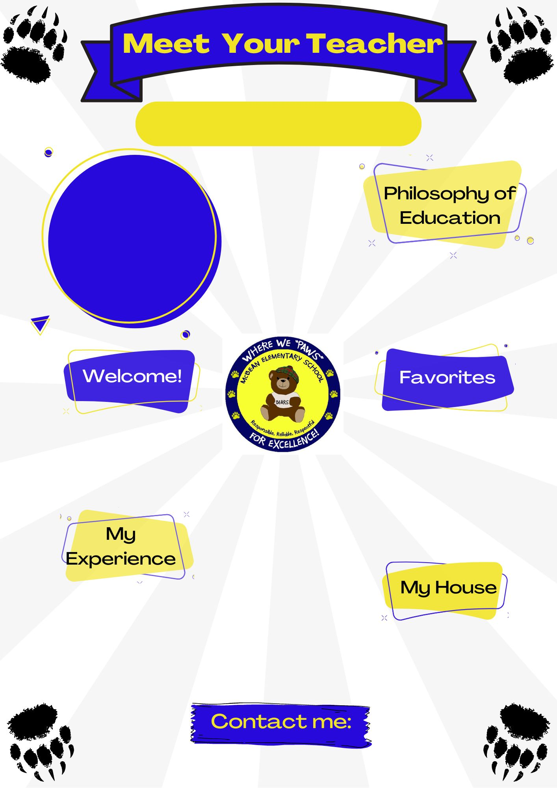
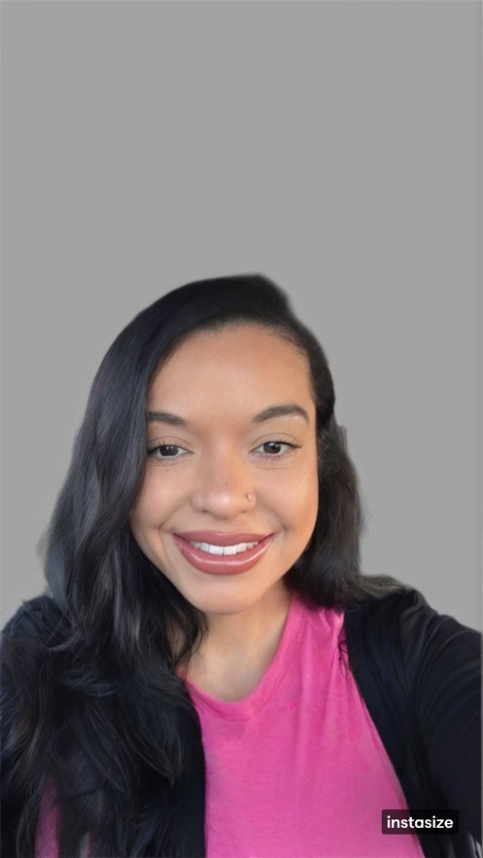
Jazlyn Foster
Job Title
Special Education
Teacher
Kindergarten & 3rd grade
"If they can't learn the way we teach, we teach the way they learn."
-Dr. O. Ivar Lovaas
Hello! I am excited for this school year and all the growth we will make together.
Color(s): PINK!
Animal(s): Dogs and Elephants
Hobby: Working out & Shopping
Sport: Basketball
Book: The Bad Seed by Jory John
Movie: The Notebook
Food: Crab legs from Top Crab and Chick Fil A.
Drink: Dunkin (Iced Coffee)
5 ½ years in special education.
Bachelors of Arts in Sociology and Criminal Justice from UNC Pembroke.
Masters of Arts in Teaching Special Education from Fayetteville State University.
Fosteja@boe.Richmond.k12.ga.us

